Slide 1
The Circular Character of Building Tradition: Which challenges for the HUL Approach
Marco Acri, Saša Dobričić, Jukka Jokilehto
University of Nova Gorica (ETCAEH)
Marco.acri@ung.si
ANNUAL STS Conference, GRAZ 2019
S18: Is the circular economy able to transform the built environment in cities?

Slide 2
MAIN CONTENTS
The traditional vs contemporary building techniques (in the linear economy): The Historic building site: Materials, technologies, skills. The issue of maintenance;
What about Genius Loci? Territorial or social identity? Sense of Place?
The morphology of the city and the typology of historic urban buildings. Urban preservation and Historic Urban Landscape;
Circular Economy in urban contexts: sustainability, complementarity, social integration, use and not ownership.

Slide 3
The traditional vs contemporary building techniques (in the linear economy): The Historic building site: Materials, technologies, skills. The issue of maintenance

Slide 4
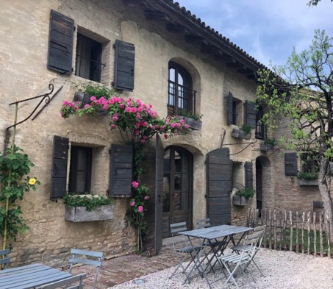
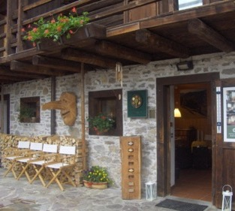
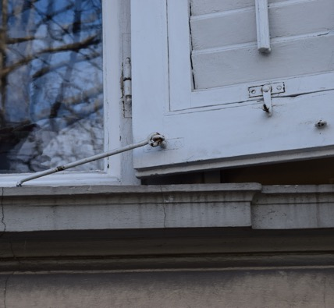
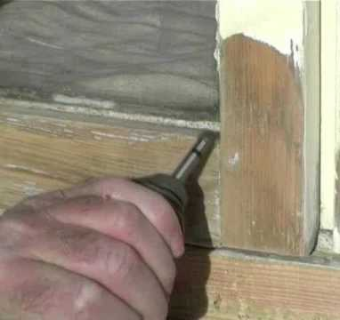
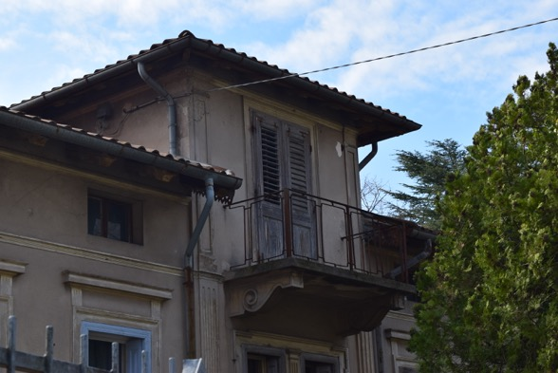
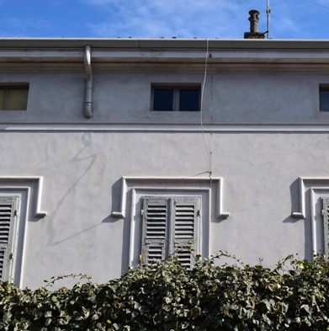
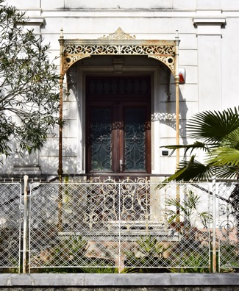
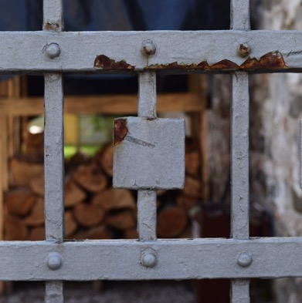
The Traditional techniques, as developed until the 19th century

Slide 5
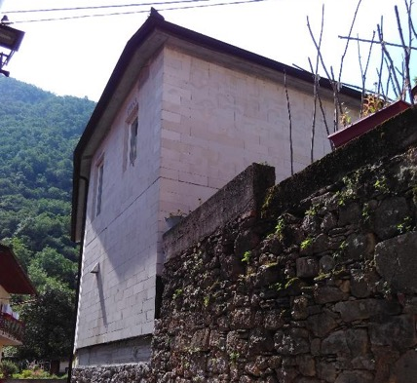
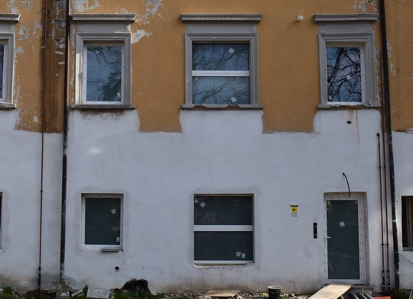
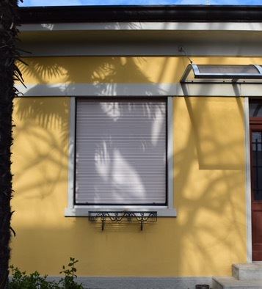
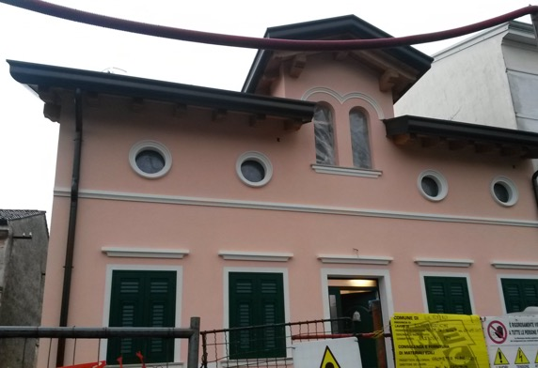
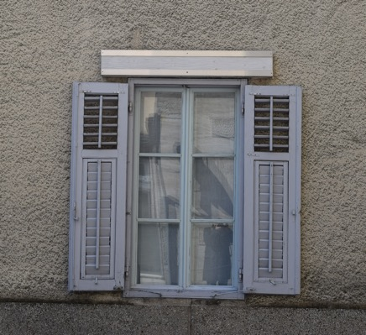
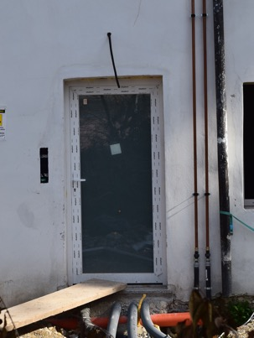
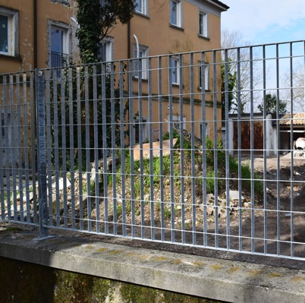
The Traditional techniques, as developed until the 19th century

Slide 6
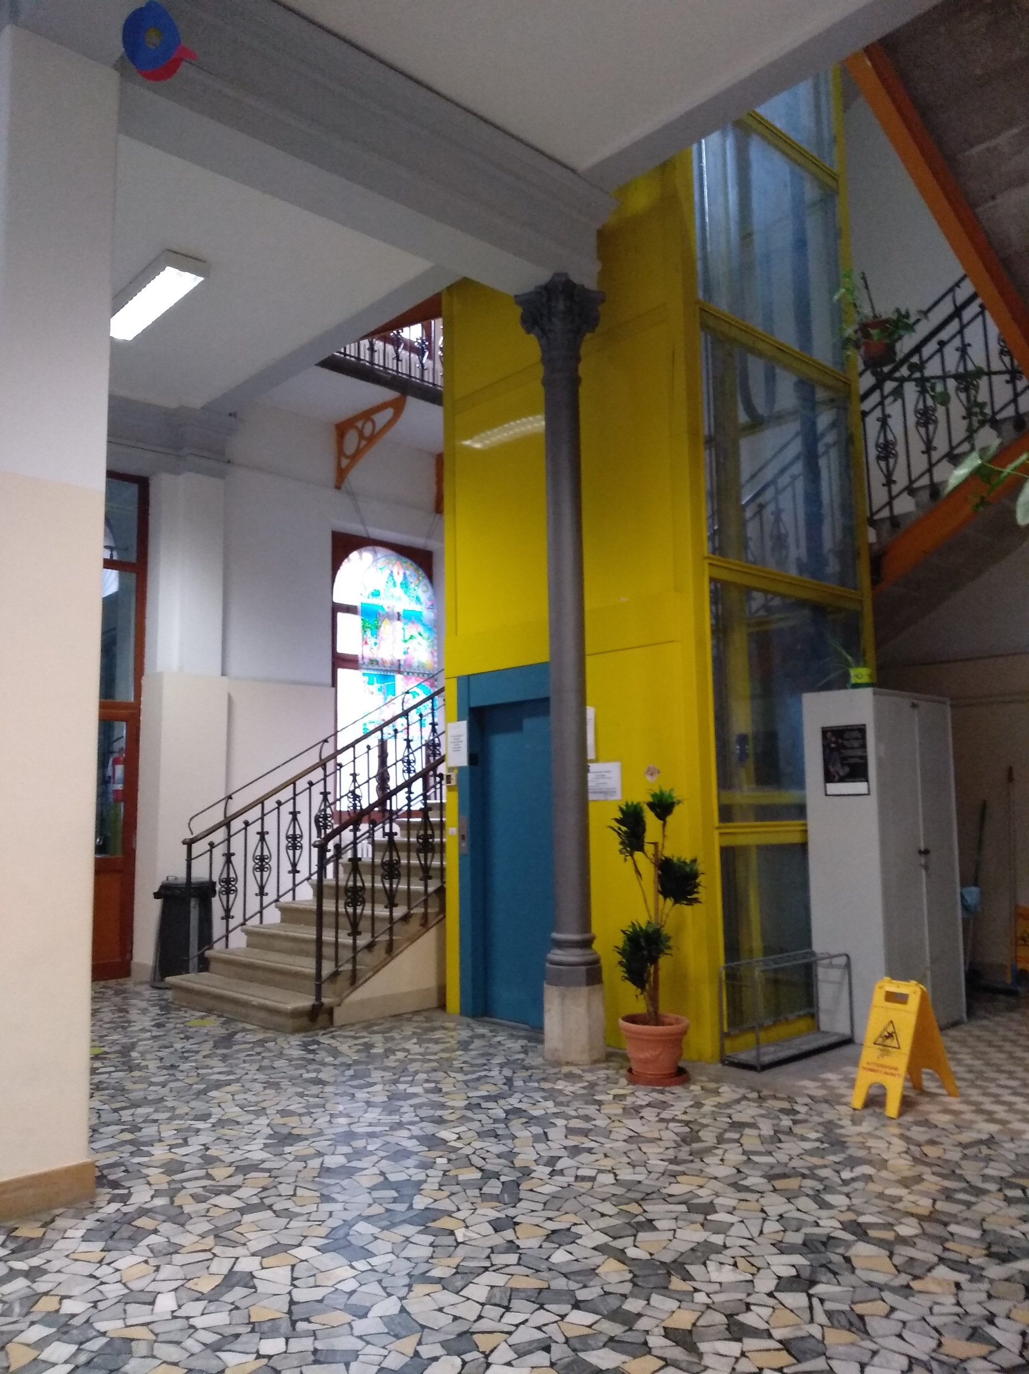
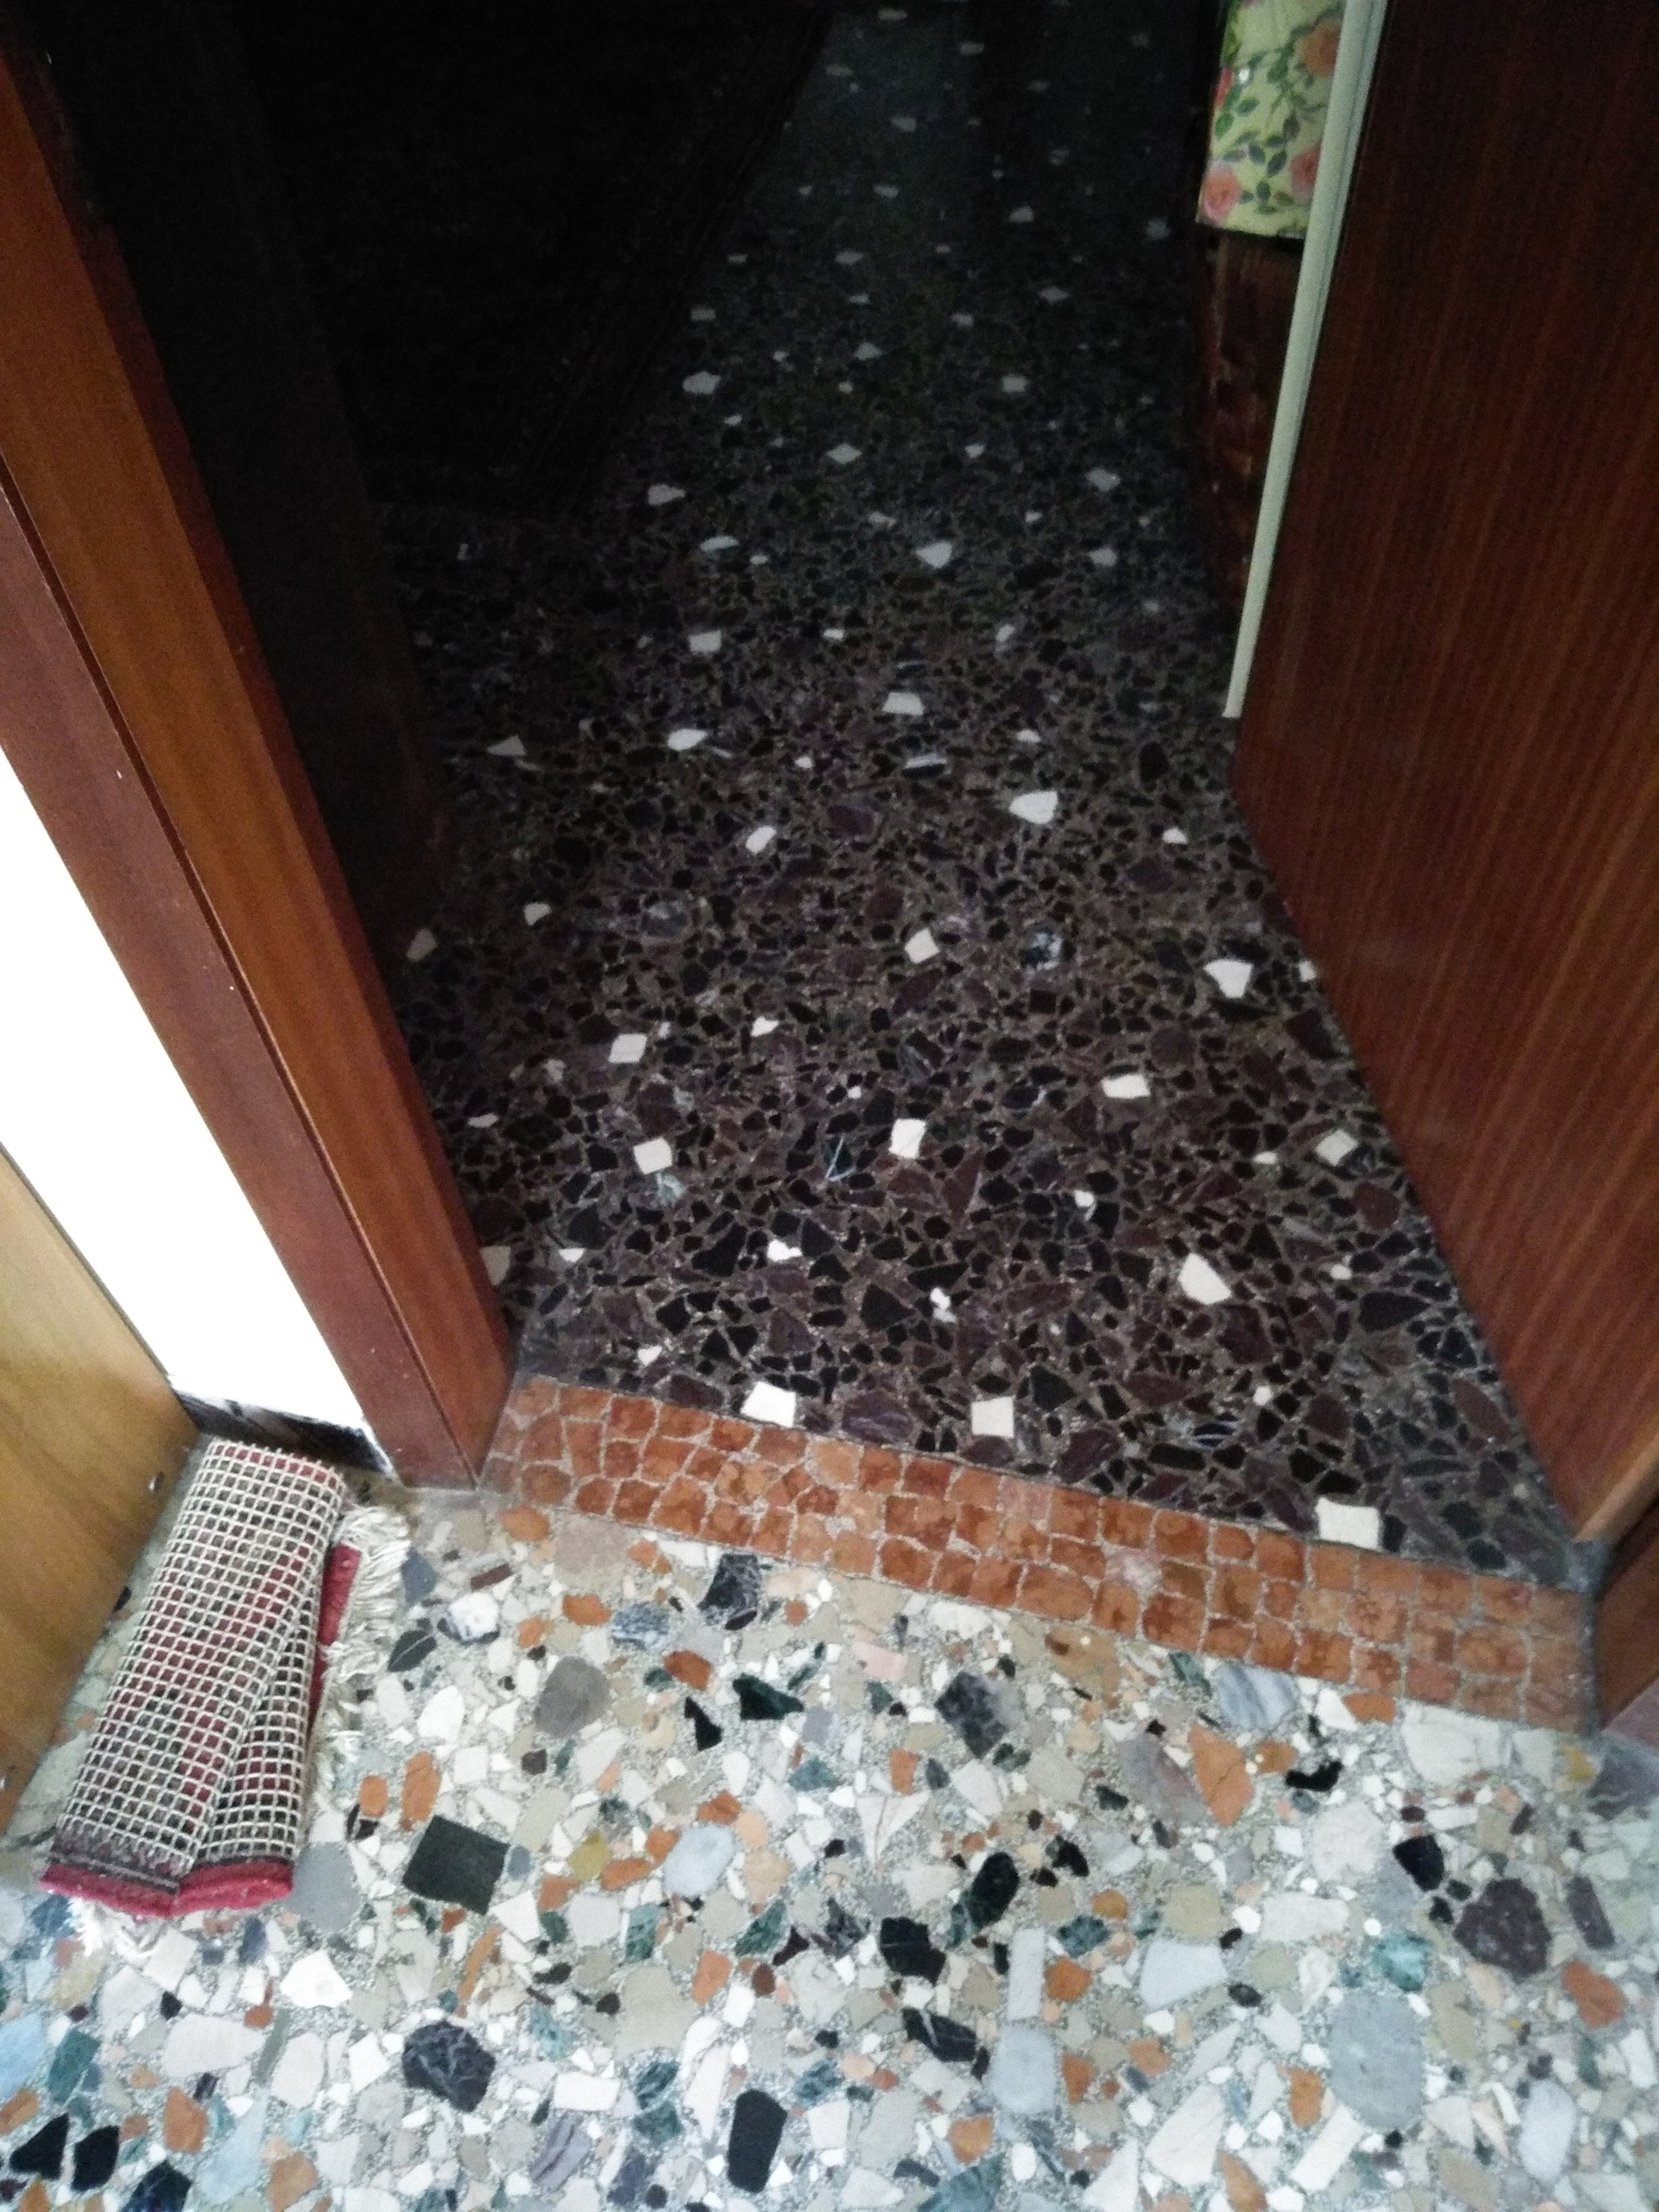
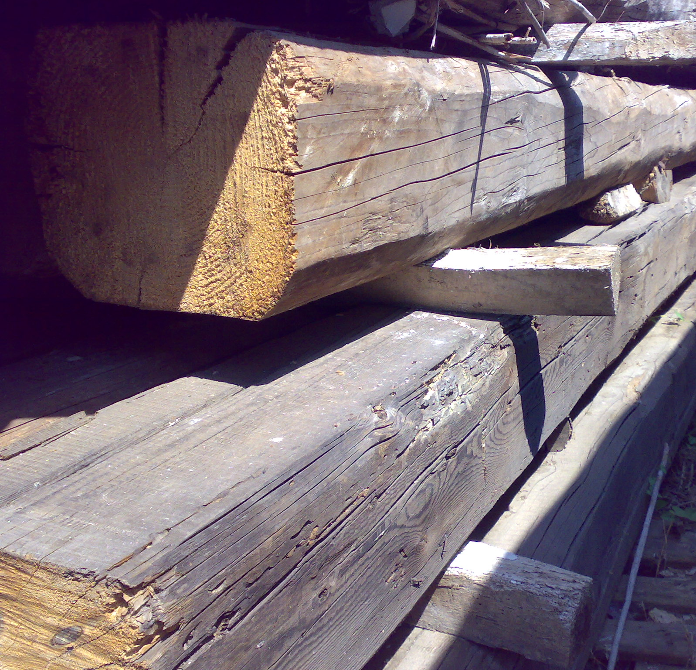
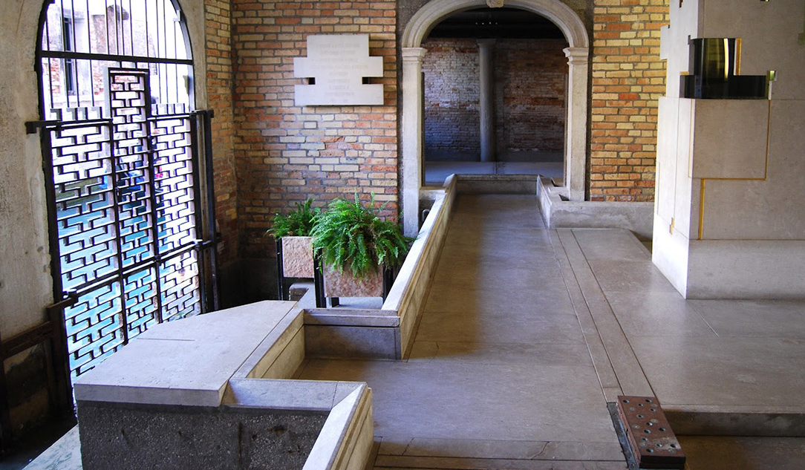
The Traditional techniques, as developed until the 19th century
The maintenance and restoration in historic building sites havae always be circular, for different reasons:
Low labour costs/manpower
High costs of materials
High costs of infrastructures and transportation modes
Difficult transportation modes inside and outside the building material
Difficulty in production of raw materials
The maintenance and Importance of creative design, also in the historic practice

Slide 7
What about Genius Loci? Territorial or social identity? Sense of Place?

Slide 8
Genius Loci
Genius Loci refers to the specific creative inputs that is generated by a specific territory. Historic development associated to climatic conditions create different, peculiar, place oriented human responses for adaptation.
This means that the tangible manifestations of human adaptations represent a proof of the history of a territory.
Traditional buildings, as well as traditional crafts and knowledge are expressions of the genius loci, of the adaptation of human beings to specific environments, beyond cultural “contaminations” and before globalization trends.
Genius loci may be visible in architecture, infrastructural solutions, landscaping, crafts and popular rituals and festivities.

Slide 9
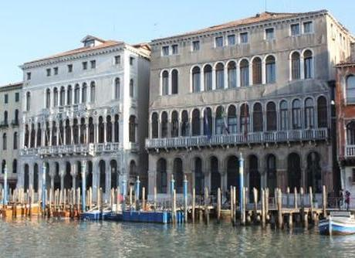
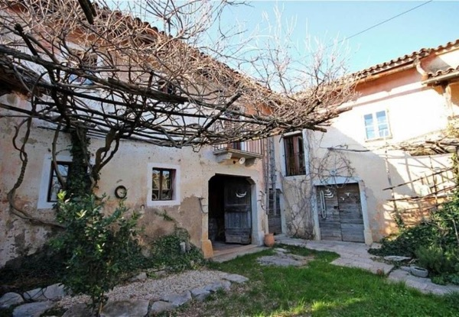
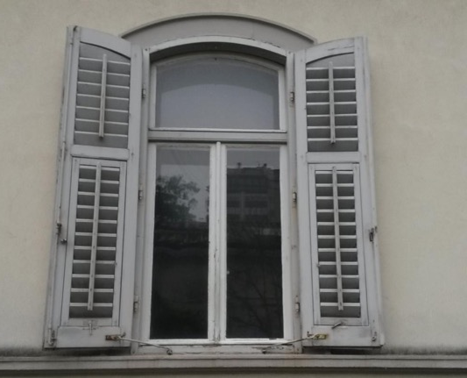
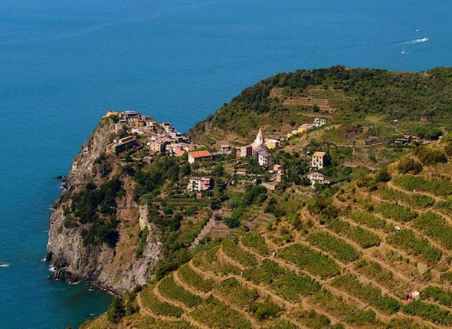
Genius Loci
But is this the product of present generations, is this part of personal identity?

Slide 10
Sense of Place
Sense of place is for many corresponding to the genius loci, although it should be understood with an additional dimension, the social one. The sense of place indeed refers to the present use of the place in line with its genius loci
The sense of place reflects the historic development, the peculiarities that made a space place for a specific group of individuals in time. Sense of place refers to the use of the space.
Traditional buildings and local traditions give the “tangible” contextualisation of the place and their respect, maintenance, contribute to the preservation of this sense.
If a traditional architecture may be considered unique or peculiar, the sense of place make it even more unique. The sense of place contribute to the quality of life as one is relating to his own environment.

Slide 11
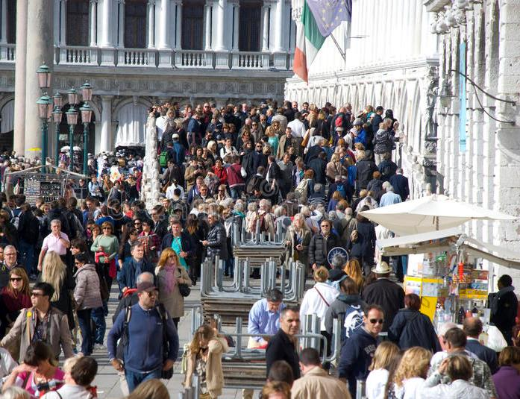
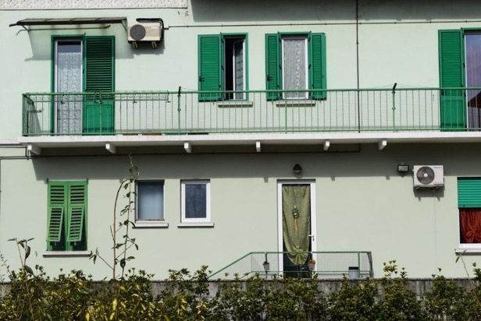
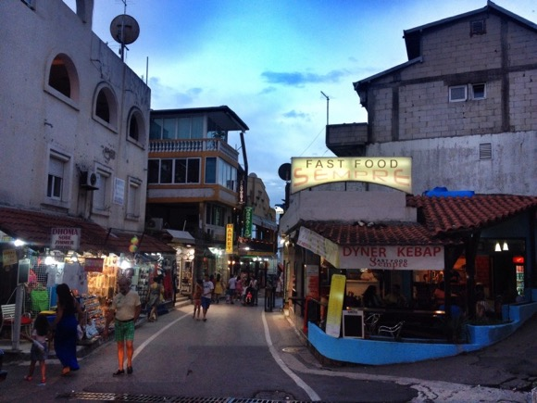
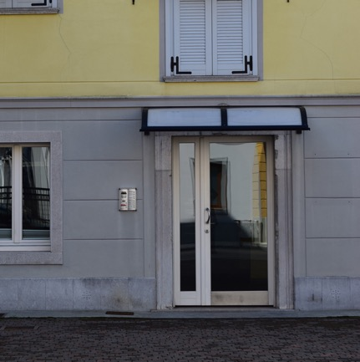
Genius Loci
But this is not the product of present generations, this is not people identity

Slide 12
The morphology of the city and the typology of historic urban buildings. Urban preservation and Historic Urban Landscape;

Slide 13
Sense of Place
The conservation of historic urban areas became the key issues in the 1975 European Architectural Heritage Year
The modern urban conservation methodology, which has developed since the 1970s considers one of the basic issues “how you define the significance of the built heritage in reference to social-functional, historical-structural, and aesthetic-visual aspects, within the context of the urban morphology of the settlement concerned. We also need to understand this settlement within its social, cultural, economic and environmental context. There are planners, who base their projects on the evaluation of the architectural and historical merits of individual buildings. Often, this means identifying some characteristics that represent those qualities or value judgments. Such buildings can then be adapted to new uses with the condition that these qualifying characteristics are maintained or preserved. As a result, there is a risk to lose the qualities of the historic urban territory.

Slide 14
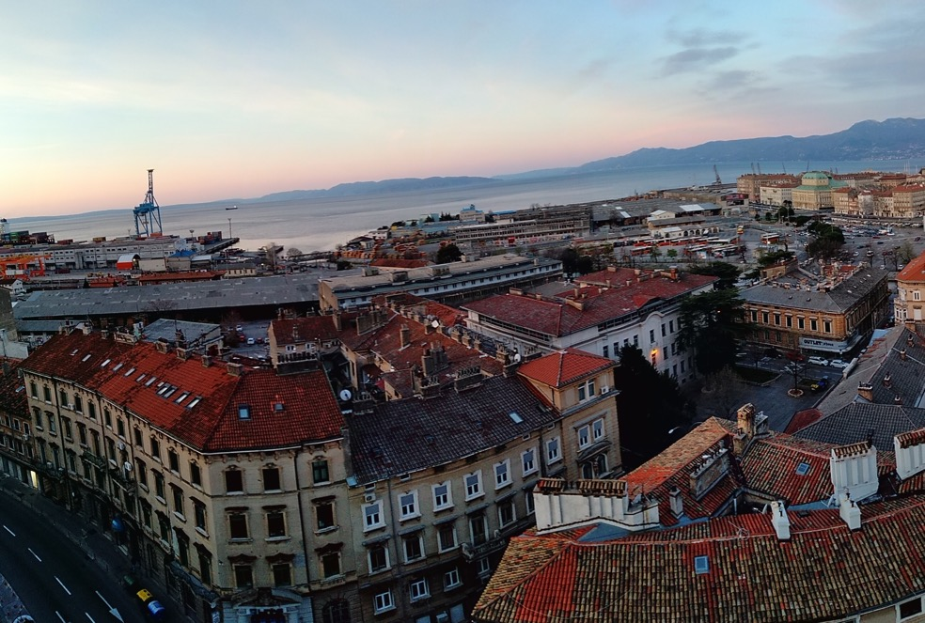
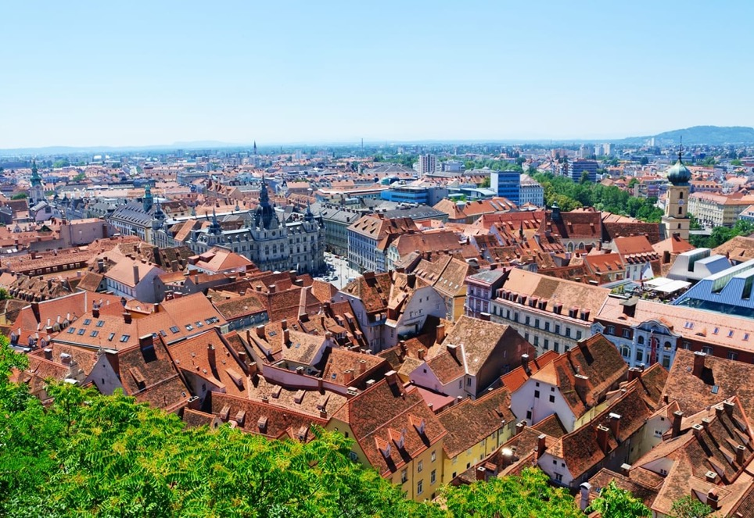
HUL or Panorama?
C WHLOVERS

Slide 15
Integrated Urban Conservation – Morphology and Typology
The idea of integrated urban conservation, instead, is based on the recognition of the historic urban morphology, and the integrity and authenticity of associated urban fabric within the context. The morphology is based on the gradual evolution of the historic city in response to the evolving local economic structure. As a result, research is needed in the identification of the functional and architectural typology of the urban fabric. These analyses and associated verification of the degree of conservation of the traditional typology, the present use and condition of the built structures as well as open areas, can be taken as a reference for the assessment of strategies for rehabilitation, and assessment of the limits of change compatible with potential new uses.
Consequently, we should look at the issue of adaptive reuse primarily in reference to the historic urban context, and secondly in reference to the typology and historical stratigraphy that the individual structures represent.

Slide 16
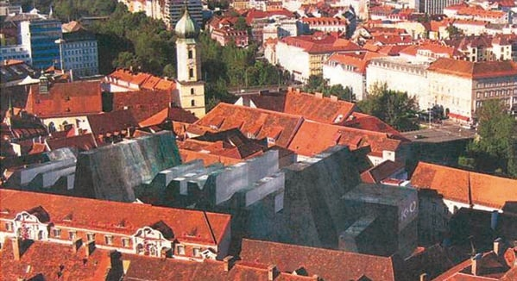
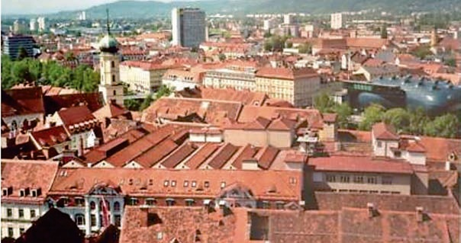
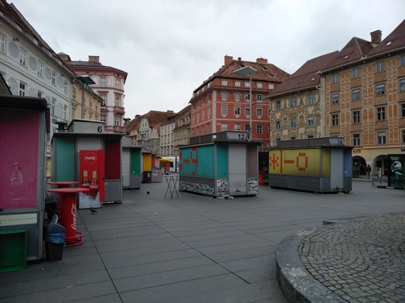
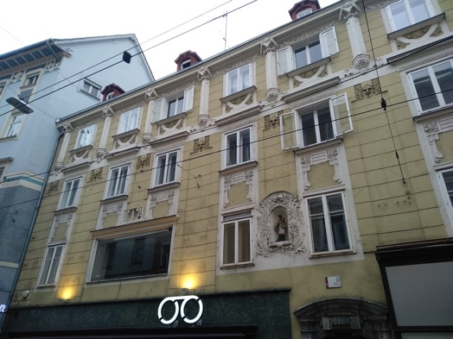
Urban Morphology and the Insertion of the New

Slide 17
Integrated Urban Conservation – Morphology and Typology
Breaking the Urban Tissue and the urban typologies may generate trends of excessive tout-court innovation that in the long run totally change the urban character.
The relationship between interiors and exteriors in architecture are strong in the building techniques evolution. Excessive, continuous changes in the interiors, as much as in the exteriors, take to misunderstandings of the local authenticity, beyond the loss of structural, material and “visual” integrity.
The HUL approach is a global evolution of the Modern Urban Conservation Methodology and the principle is how to guarantee an urban ecology – not merely generating new urban dynamics

Slide 18
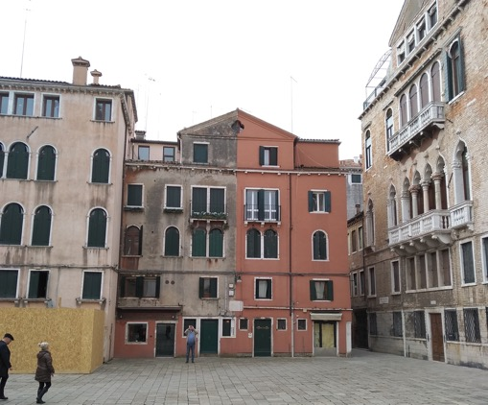
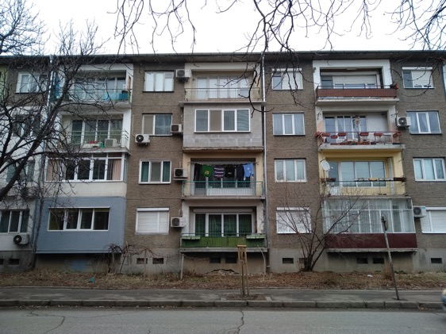
What is Circularity and Urban Contexts (HUL)
Use instead of property ownership – how individual choices are impacting? Democracy?
Common Goods and Common Pool Resources
Democratization, but within the rules and the limits
Economy of use not of ownership

Slide 19
Circular Economy in urban contexts: sustainability, complementarity, social integration, use and not ownership.

Slide 20
What is Circularity and Urban Contexts (HUL)
CIRCULAR MODELS IN HERITAGE ADAPTIVE REUSE REFER TO DIFFERENT LEVELS AND SUBJECTS:
Respect of integrity and authenticity – promoting maintenance instead of renewal
Materials recycling and re-scaling – generating virtuous mechanisms that reproduce the historic building site
Objects/Finishings/Furniture reuse and re-scaling - generating virtuous mechanisms that reproduce the historic building site
Multifunctionality – giving the urban tissue intensity in use
Generation of economies based on culture and nature – this means creating an aesthetic community
Resilience as regenerating -
Retrofitting – as respecting integrity
Community/collectivity engagement or simple awareness

Slide 21
What is Circularity and Urban Contexts (HUL)
Circulare economy in urban context must then act at different levels, not only in the buildings adaptive reuse:
it is about objects – the micro scale
It is about buildings and their maintenance – the meso scale
It is about about urban ecosystems – the macro scale
More than punctual projects, the importance is given to governance, that is how micro-meso and macro are interrelated.
To reach the micro awareness raising is needed, as well as acting on the level of commons;
To reach the meso awareness raising should be merged to training, given that professionals themselves do not promote the “right thing”;
To reach the macro, courageous policies should be put in place, recognizing the primary role of culture and nature in the citizens well-being

Slide 22
Few References
Acri M., Dobricic S. (edited by), Creative Cities: Which (Historic) Urban Landscape?, Mimesis, Milan, 2017
Hayden D., The Power of Place - Urban Landscapes as Public History, MIT, Cambridge (MA) and London,1997
Norberg-Schultz C., Genius Loci: Towards a Phenomenology of Architecture, Rizzoli, New York, 1979
Ostrom E., Gardner R., Walker J., (edited by), Rules, Games, and Common Pool Resources, Ann Arbor, University of Michigan Press, 1994
Stanley Price N., King J., Conserving the Authentic – Essays in Honour of Jukka Jokilehto, ICCROM Conservation Studies, Rome, 2009
Zumthor P., Atmospheres, Birkhauser, Basel, 2006

Slide 23
Marco Acri University of Nova Gorica CLIC Project
ANNUAL STS Conference, GRAZ 2019
S18: Is the circular economy able to transform the built environment in cities?

